Slide 1
stock Portfolio Generator
Mwansa, Pete and Michelle

Slide 2
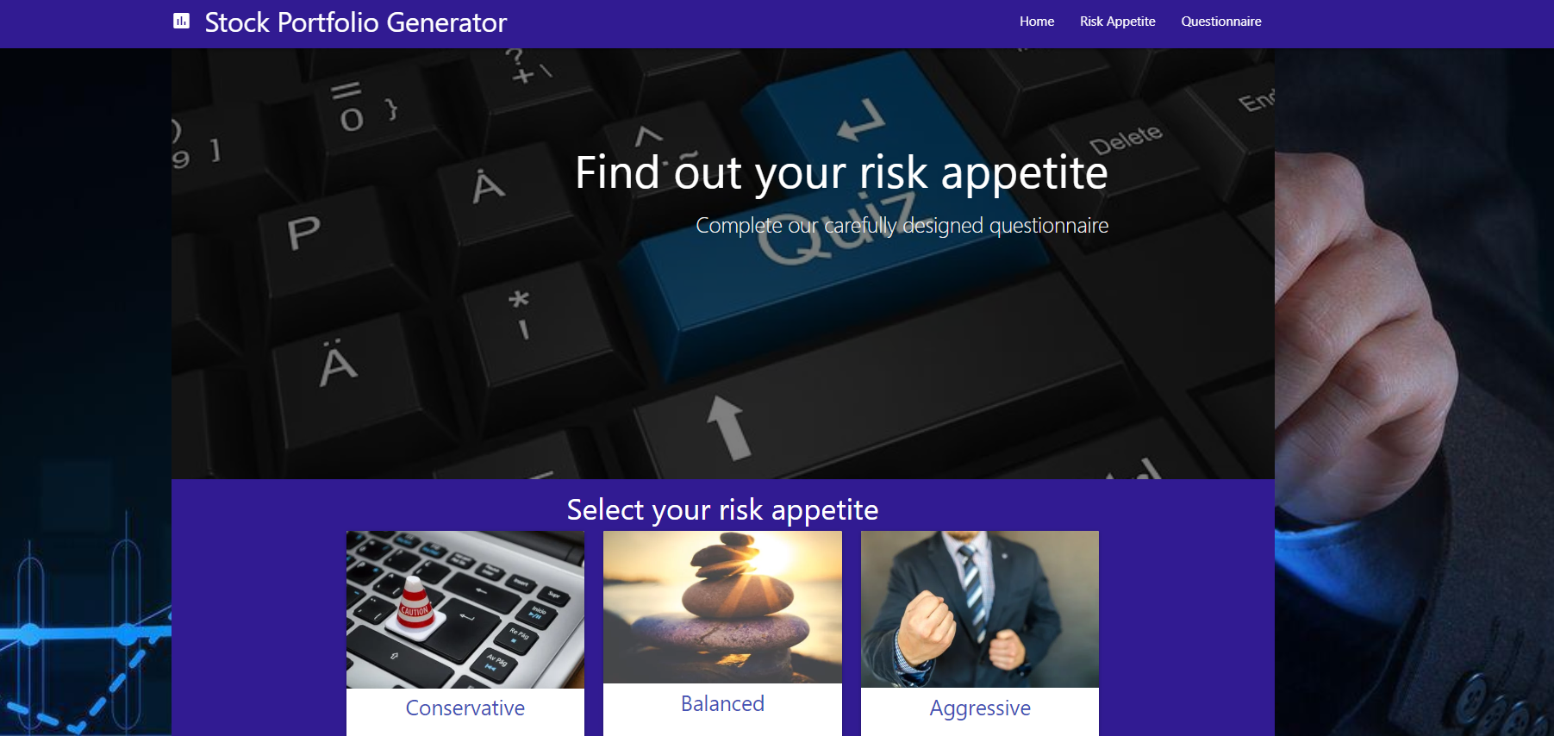
Elevator pitch
Notes:
A one minute description of your application by Michelle

Slide 3
Concept
Motivation
User Story
When l open the app, I am presented with a selection of conservative, balanced or aggressive risk tolerance options;
If l know my risk tolerance, I select an option that aligns with my risk tolerance and l am presented with stocks that align my risk profile;
If l don’t know my risk profile, I select the option to participate in a quiz that is designed to determine my risk tolerance based on a set of carefully selected questions and a set algorithm;
Once my risk tolerance is determined from the quiz, I am presented with a selection of stocks that align my risk profile;
When l click on each stock suggestion, I am presented with top news stories about my recommended stocks;
Notes:
Pete
Motivation –the motivation of this app is drastically falling share prices due to COVID-19. In these times, we believe it is still important that individuals don’t get caught up in the confusion and hype. We must continue to make educated investment decision that remain appropriate for our needs and risk tolerance. The app is designed to ensure that we continue to target stocks that align with our risk tolerance using a beta measurement.

Slide 4
Process
Technologies used: Gitkraken, Github, VS Code, Yahoo Finance API, News API
Tasks: Finance API, News API, Questionnaire, UI, Integration
Challenges: Finding appropriate API, API call limits (calls/month & calls/second)
Success’: Happy with result, Github team functions, Team Work!
Notes:
Pete
Technologies Used:
Gitkraken
Github
VS Code
Tasks:
Breakdown of Tasks
Challenges:
Locating an appropriate API with beta values;
Ensuring our API calls don’t run out as our app requires us to call and loop 50 stocks in one click;
Modals
Success:
We have something to present;
Everyone has worked well together;
We’ve all had go at using the functionalities on github

Slide 5
Demo
Notes:
Mwansa

Slide 6
Directions for Future Development
Improving
Improving the UX;
Creating
Creating a fully diversified portfolio with carefully selected assets in cash, property, Australian shares, International Shares and fixed income;
Instructions
Adding links and directions on how to purchase shares;
Conducting
Conducting a financial review based on user input;
Notes:
Michelle

Slide 7
Links
Deployed
https://mitchelle-b.github.io/Asset-Portfolio-Generator/
GitHub repo
https://github.com/Mitchelle-B/Asset-Portfolio-Generator

